Slide 1
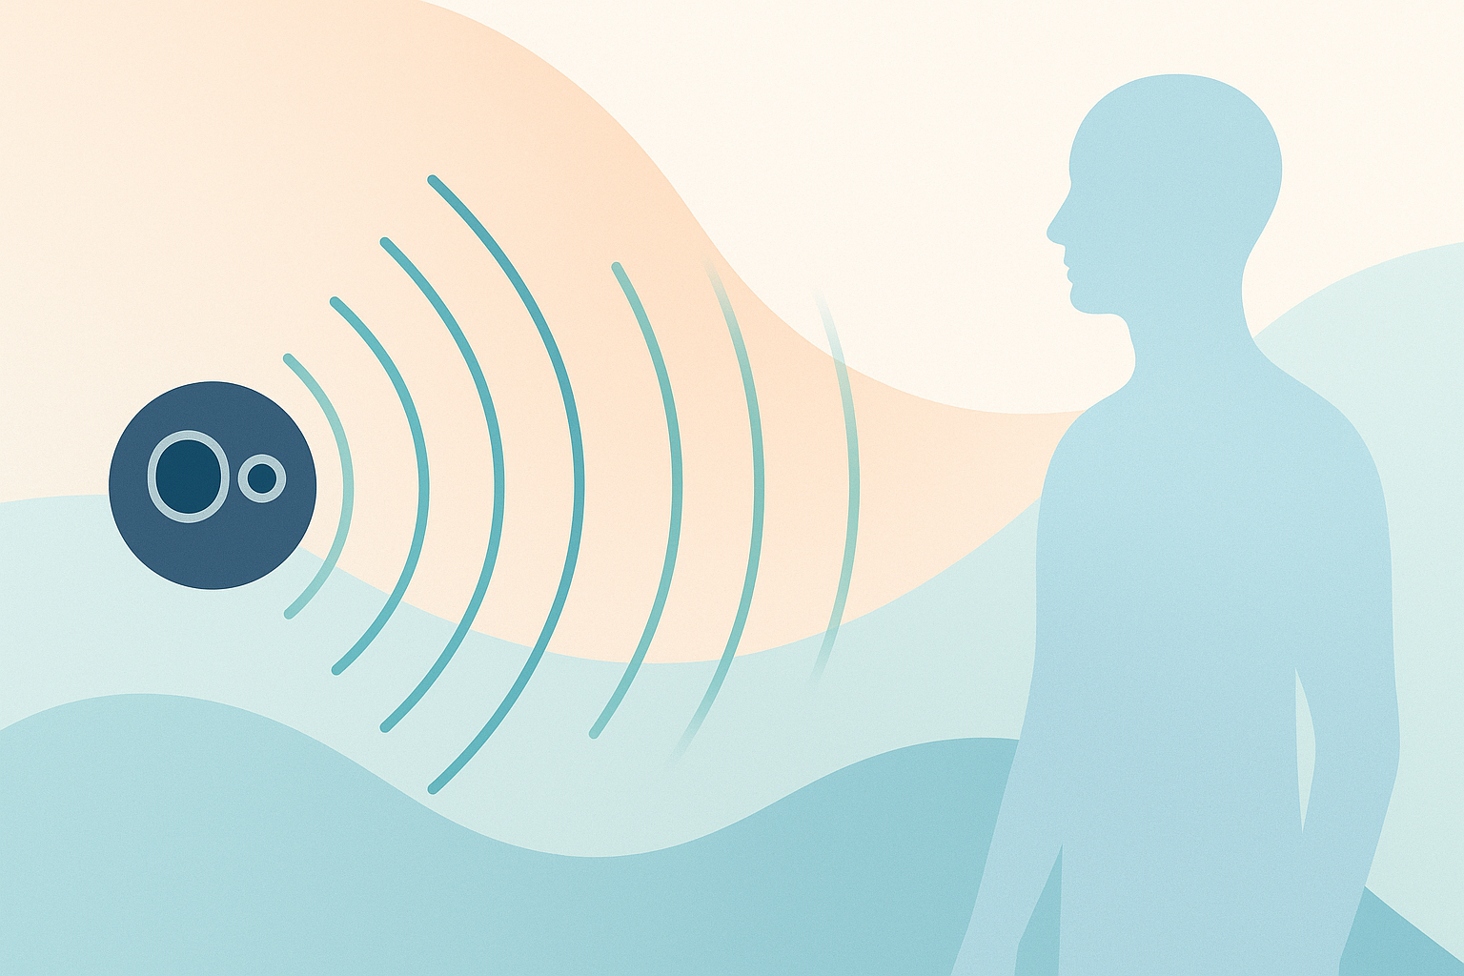
Ultrasonic Navigation Aid
for the Visually Impaired
Empowering mobility with intelligent sensing and haptics

Slide 2

Problem & Motivation
• Navigating complex environments without vision is hazardous and exhausting. • Traditional canes provide limited range and do not anticipate overhead obstacles. • Falls and collisions lead to injuries, loss of independence and reduced quality of life. Our goal: deliver an affordable, wearable sensing system that notifies the user of obstacles and trenches through intuitive haptic feedback.

Slide 3
Hardware Architecture
Sensor 1
(Obstacle)
Servo
(Sweeping)
Microcontroller
Sensor 2
(Trench)
Vibration
Motor
Bluetooth
Module
• HC‑SR04 sensors mounted at 1 m height
• Second sensor fixed at 60° detects trenches
• Servo sweeps 30°–150° for obstacle detection
• Vibrator on D9 warns user to stop

Slide 4
Algorithm & Pin Assignments
1. Rotate the first sensor via servo motor through an angular sweep (150°→30°). 2. At each angle, measure ultrasonic echo time without blocking the Bluetooth link. 3. Convert echo time to distance; use trigonometry to compute horizontal range: dₐ = dₒ · cos(θ). 4. Trigger vibration motor if an obstacle is within 1.5 m or if the fixed sensor reports a trench. 5. Transmit JSON: {"sensorObstacle": dₐ, "sensorTrench": dₒ}
θ
dₒ
dₐ
Pin | Function
D7 | Sensor 1 Trigger
D8 | Sensor 1 Echo
D10 | Sensor 2 Trigger
D11 | Sensor 2 Echo
D9 | Vibration Motor
D3 | Servo PWM
D1/D0 | Bluetooth Tx/Rx

Slide 5
Bluetooth Data & Firmware Design
Example Payload {
"sensorObstacle": 1.23,
"sensorTrench": 0.45
}
• Non‑blocking measurement: avoid pulseIn() to keep serial link responsive. • 9600 bps UART via HC‑05/HC‑06 ensures reliable Bluetooth transmission. • JSON formatting enables integration with mobile apps and logging systems. • Data can be analysed remotely for usage insights and health monitoring.

Slide 6

Issues & Potential Fixes
• Limited range (~4 m) and diminished accuracy at longer distances. • Sensitive to temperature, humidity and environmental noise, leading to false readings. • Difficulty detecting small, angled or absorbent obstacles.
• Integrate LiDAR sensors for longer range (>10 m) and higher precision. • Fuse multiple modalities: combine ultrasonic, LiDAR and IR to improve robustness. • Apply digital filtering (median or Kalman) to reduce measurement noise. • Increase sampling resolution or explore 2D LiDAR for richer spatial maps.

Slide 7
Impact & Innovation
• Extends situational awareness beyond the reach of a cane. • Distinguishes overhead obstacles, walls and drop‑offs. • Discreet haptic cues enhance confidence without noise. • Open protocol enables integration with assistive apps.

Slide 8
Conclusion & Roadmap
• Prototype demonstrates safe obstacle and trench detection using dual ultrasonic sensors and trigonometric ranging. • Haptic alerts on D9 pin provide immediate feedback without disturbing others. • Bluetooth connectivity and JSON payloads enable logging, analytics and mobile notifications. • Next steps: optimise battery life, refine haptic patterns, miniaturise hardware and explore AI for object classification.
Together, let’s make navigation safer and more inclusive.

